Slide 1
Weight Regain in Bariatric Patients, The Impact of Neonatal Formula Feeding
MADDALENA PAOLICELLI
Universita’ degli studi della campania luigi vanvitelli, napoli.

Slide 2
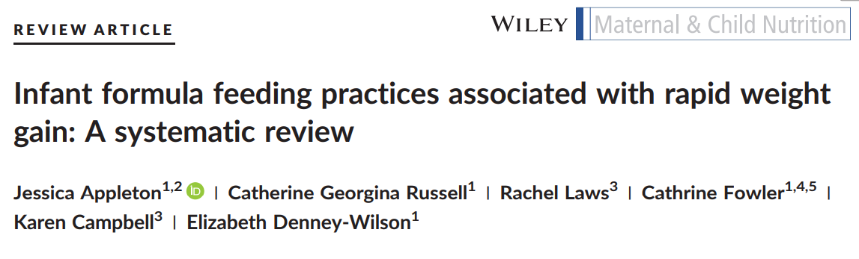
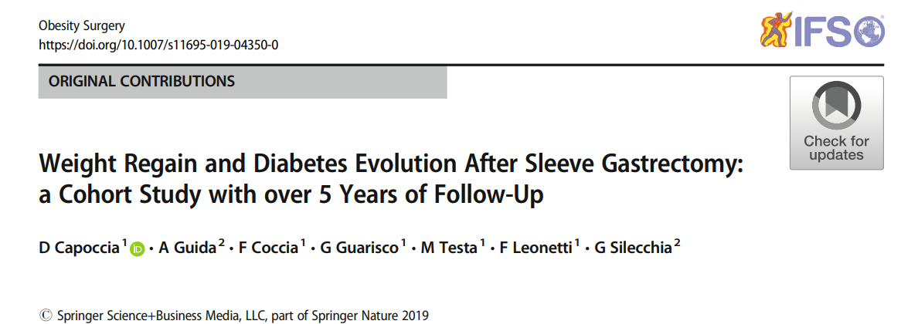

A known risk factor for the development of obesity and related disorders in adulthood
Obesity and formula-fed
Infant feeding type may also influence long-term weight dynamics after bariatric surgery.
Long-term weight regain (WR) following SG remains a significant clinical challenge

Slide 3


A retrospective, single-center study
from January 2007 to March 2023
comparing brestfed and formulafed groups
age between 18 and 59 years
body mass index (BMI) ≥35
sleeve gastrectomy (SG)
— including Nissen-sleeve
and intragastric balloon (BIB)
follow-up period of 24 months
Primary outcome: to evaluate weight regain (WR) and the body mass index (BMI)
Secondary outcome: to assess the remission of blood hypertension and type 2 diabetes mellitus

Slide 4

Results: study population
Tab.1 Baseline Characteristics by Infant Feeding Type
 | Overall | Brestfed | Formula-Fed | P value
 | 107 | 65 | 42
Age | 41.0 [32.5, 47.0] | 42.00 [35.00, 47.00] | 40.00 [30.25, 48.00] | 0.5
Sex = M% | 31 (29) | 22 (33.8) | 9 (21.4) | 0.24
BMI | 45.6 (5.69) | 45.42 (5.42) | 45.97 (6.13) | 0.62
Diabetes % | 20 (18.7) | 12 (18.5) | 8 (19) | 1.00
Hypertension % | 42 (39.2) | 29 (44.6) | 13 (31) | 0.22
Sleeve % | 97 (91.5) | 56 (87.5) | 41 (97.6) | 0.18

Slide 5
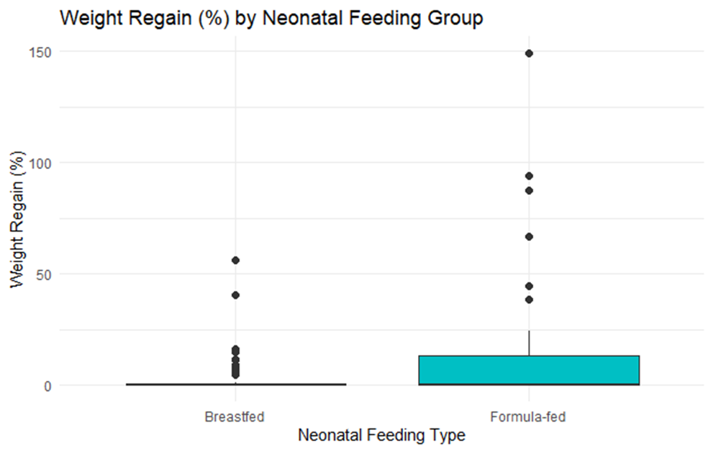
Primary outcome: Welch’s t-test
Mean WR Brestfed group | 3.50
Mean WR Formulafed | 14.96
T-statistic | -2.2662
Degrees of freedom | 44.70
P value | 0.028

Slide 6
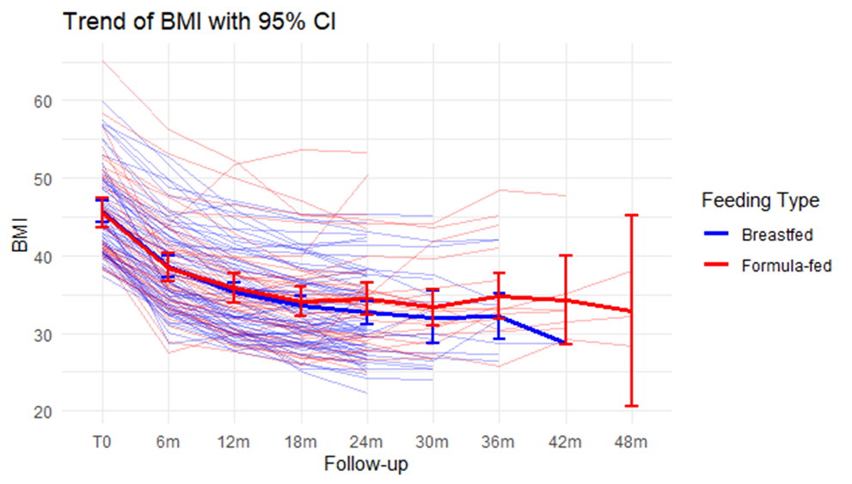
Primary outcome: BMI trend
The breastfed group appeared to maintain a more consistent BMI reduction, particularly during the last six months
Both groups showed a marked reduction in BMI between baseline (T0) and 6 months, followed by a more gradual decrease up to 24 months.

Slide 7
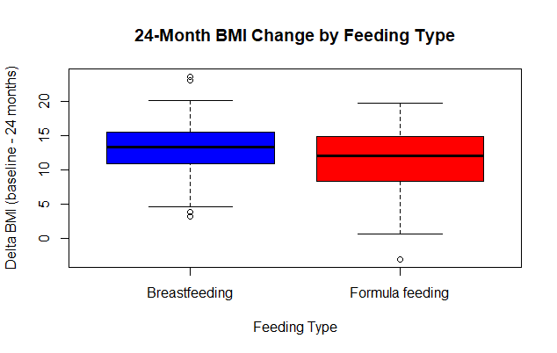
Primary outcome: Δbmi
The difference between groups was statistically significant, with a t-value of 2.0027 and a p-value of 0.0489. Although the p-value is just below the conventional threshold of 0.05, it supports the presence of a significant difference in BMI change between the two groups. The 95% confidence interval for the difference in means ranged from 0.009 to 3.83, confirming the statistical significance of the finding.
Table 2. Comparison of ΔBMI at 24 Months Between Groups (Welch Two Sample t-test)
Parameter | Brestfed | Formula-fed | Difference (Group 0 − Group 1)
Mean ΔBMI | 13.16 | 11.24 | 1.92
95% Confidence Interval |  |  | [0.009, 3.83]
t-value |  |  | 2.00
p-value |  |  | 0.049
The mean ΔBMI in the non-formula-fed group was 13.16, while in the formula-fed group it was 11.24, indicating a greater mean BMI reduction of approximately 1.92 points in the non-formula-fed group.

Slide 8
Primary outcome: counfounding factors
Linear regression model for 24-month BMI change, Results adjusted for sex, age, hypertension, and diabetes.
 | Coefficient (β) | Std. Error | t value | P value
(Intercept) | 12.75 | 2.00 | 6.36 | <0.001
Formula feeding (yes vs. no) | -1.94 | 0.93 | -2.08 | 0.04
Sex (male vs. female) | 0.88 | 1.06 | 0.83 | 0.41
Age (years) | 0.02 | 0.05 | 0.39 | 0.69
Hypertension (yes vs. no) | -1.61 | 1.11 | -1.45 | 0.14
Diabetes (yes vs. no) | 0.05 | 1.20 | 0.04 | 0.97

Slide 9
Secondary outcome: McNemar test
Tab.3 Diabetes – BrestFed Group
 | Diabetes After: No | Diabetes After: Yes
Diabetes Before: No | 54 | 0
Diabetes Before: Yes | 10 | 1
Tab.4 Diabetes – Formula-Fed Group
 | Diabetes After: No | Diabetes After: Yes
Diabetes Before: No | 33 | 0
Diabetes Before: Yes | 4 | 5
Tab.5 Hypertension – Brest-Fed Group
 | Hypertension After: No | Hypertension After: Yes
Hypertension Before: No | 38 | 0
Hypertension Before: Yes | 19 | 8
Tab.6 Hypertension – Formula-Fed Group
 | Hypertension After: No | Hypertension After: Yes
Hypertension Before: No | 26 | 1
Hypertension Before: Yes | 12 | 3
Chi-squared (1) = 8.10, p = 0.0044
Chi-squared (1) = 2.25, p = 0.1336
Chi-squared (1) = 17.05, p < 0.0001
Chi-squared (1) = 7.69, p = 0.0055

Slide 10
Conclusions
Formula feeding in infancy was independently associated with:
significantly smaller reduction in BMI.
greater weight regain at 24 months post-surgery.
The BMI difference was modest (~1.9 points) but statistically significant
The association remained consistent across multiple adjusted analyses.
Early-life nutrition may influence long-term bariatric outcomes, supporting the idea that infant feeding practices have lasting metabolic effects.

Slide 11
Limitations
A retrospective study: information bias, unmeasured confounding factors
Data missing
Long latency period between exposure and outcome
Predictive power was low, suggesting other important contributors (behavioral, genetic, environmental).
Need for larger, prospective studies.

Slide 12

Thank you!

Slide 13
References
Felsenreich DM, Bichler C, Langer FB, Gachabayov M, Prager G. Sleeve Gastrectomy: Surgical Technique, Outcomes, and Complications. Surg Technol Int. 2020 May 28;36:63-69. PMID: 32359172.
Appleton J, Russell CG, Laws R, Fowler C, Campbell K, Denney-Wilson E. Infant formula feeding practices associated with rapid weight gain: A systematic review. Matern Child Nutr. 2018 Jul;14(3):e12602. doi: 10.1111/mcn.12602. Epub 2018 Apr 14. PMID: 29655200; PMCID: PMC6866175.
Capoccia D, Guida A, Coccia F, Guarisco G, Testa M, Leonetti F, Silecchia G. Weight Regain and Diabetes Evolution After Sleeve Gastrectomy: a Cohort Study with over 5 Years of Follow-Up. Obes Surg. 2020 Mar;30(3):1046-1051. doi: 10.1007/s11695-019-04350-0. PMID: 31853861.
Arterburn DE, Telem DA, Kushner RF, Courcoulas AP. Benefits and Risks of Bariatric Surgery in Adults: A Review. JAMA. 2020 Sep 1;324(9):879-887. doi: 10.1001/jama.2020.12567. PMID: 32870301.Franz MJ, VanWormer JJ, Crain AL, Boucher JL, Histon T, Caplan W, Bowman JD, Pronk NP. Weight-loss outcomes: a systematic review and meta-analysis of weight-loss clinical trials with a minimum 1-year follow-up. J Am Diet Assoc. 2007 Oct;107(10):1755-67. doi: 10.1016/j.jada.2007.07.017. PMID: 17904936.
Melnik BC, Weiskirchen R, Stremmel W, John SM, Schmitz G. Risk of Fat Mass- and Obesity-Associated Gene-Dependent Obesogenic Programming by Formula Feeding Compared to Breastfeeding. Nutrients. 2024 Jul 28;16(15):2451. doi: 10.3390/nu16152451. PMID: 39125332; PMCID: PMC11314333.
Pérez-Escamilla, R.; Tomori, C.; Hernández-Cordero, S.; Baker, P.; Barros, A.J.D.; Bégin, F.; Chapman, D.J.; Grummer-Strawn, L.M.; McCoy, D.; Menon, P.; et al. Breastfeeding: Crucially important, but increasingly challenged in a market-driven world. Lancet 2023, 401, 472–485. [CrossRef]

